Slide 1
ESA Contribution to
Validation Supersites
CEOS WGCV LPV Plenary
15/05/2019 - Milan, Italy
Valentina Boccia
ESA Data Quality and Cal/Val Manager for High Resolution Optical Missions

Slide 2
At ESA we see the
establishment and operational exploitation of a
network of Supersites as key element of Land Product Validation.

Slide 3

We wish for the establishment of a Supersite network that:
is spread worldwide
is representative of several biomes
adopts the same validation protocols and procedures for each site
can be used to operationally validate data generated by multiple EO satellite missions (and from multiple Space Agencies)
is the result of a global effort at international level, for the benefit of the EO international users community.
Sentinel-2 - Lake Mackay, western Australia

Slide 4
ESA is contributing to the establishment of such Supersite network through:
FRM4VEG project (Fiducial Reference Measurements for Vegetation)
Preparation activities for the BIOMASS mission
Sentinel-2 - Lake Mackay, western Australia

Slide 5


FRM4VEG (Fiducial Reference Measurements for Vegetation)
The FRM4VEG project is conceived as the first step of ESA contribution to the development of a Supersites network for Land Product Validation.
FRM4VEG is currently focusing on:
Europe;
the EO data acquired by ESA optical satellites.

Slide 6
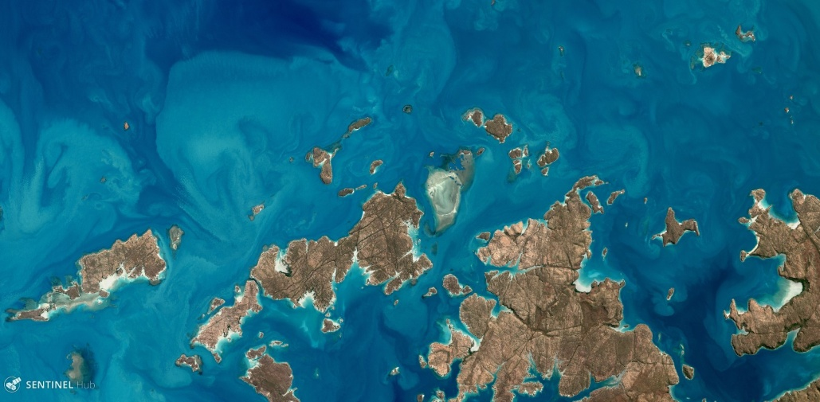
FRM4VEG (Fiducial Reference Measurements for Vegetation)
The project aims at:
Identify one or two European sites (goal: 1 forest and 1 agricultural) to be the first European Supersites for Land Product Validation, building on already existing capabilities.
Include estimation of uncertainties in the validation measurements and overall EO data validation process, so to ensure full traceability to EO data users.
Generation of fully documented Protocols and Procedures to be implemented in order to proper validate the considered EO data and ensure full traceability trough the validation process.
Identify what has to be done in order to make them actual Supersites (e.g. which instrumentation has to be permanently installed, how measurements have to be taken, how characterization of the sites has to be performed, etc.)
Bring together the international community through a dedicated Workshop in order to have a fruitful discussion on protocols, sites characterization, etc. so to achieve a common understanding and agreement.
Bring together the international community through an inter-comparison (round-robin) validation exercise performed simultaneously over the same site.
Sentinel-2, Augustus Island, Australia

Slide 7
FRM4VEG (Fiducial Reference Measurements for Vegetation)
The project aims at:
Identify one or two European sites (goal: 1 forest and 1 agricultural) to be the first European Supersites for Land Product Validation, building on already existing capabilities.
Include estimation of uncertainties in the validation measurements and overall EO data validation process, so to ensure full traceability to EO data users.
Generation of fully documented Protocols and Procedures to be implemented in order to proper validate the considered EO data and ensure full traceability trough the validation process.
Identify what has to be done in order to make them actual Supersites (e.g. which instrumentation has to be permanently installed, how measurements have to be taken, how characterization of the sites has to be performed, etc.)
Bring together the international community through a dedicated Workshop in order to have a fruitful discussion on protocols, sites characterization, etc. so to achieve a common understanding and agreement.
Bring together the international community through an inter-comparison (round-robin) validation exercise performed simultaneously over the same site.
Sentinel-2, Augustus Island, Australia

Slide 8
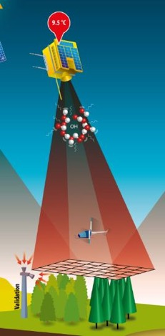
Fiducial Reference Measurements MUST…
Have documented evidence of metrological traceability to SI (or appropriate international community standard) including full uncertainty budget (instrumentation and usage);
Consider all spatial/temporal/scaling issues;
FRM4VEG
for Land products
Be independent of any satellite geophysical retrieval process;
Provide long-term sustainable mission validation information;
Be carried out following community agreed good practice protocols
(some of which still need to be written…!)
Be a direct translation of QA4EO to in-situ data;
Facilitate interoperability between sensors;
Building on the existing capabilities.

Slide 9

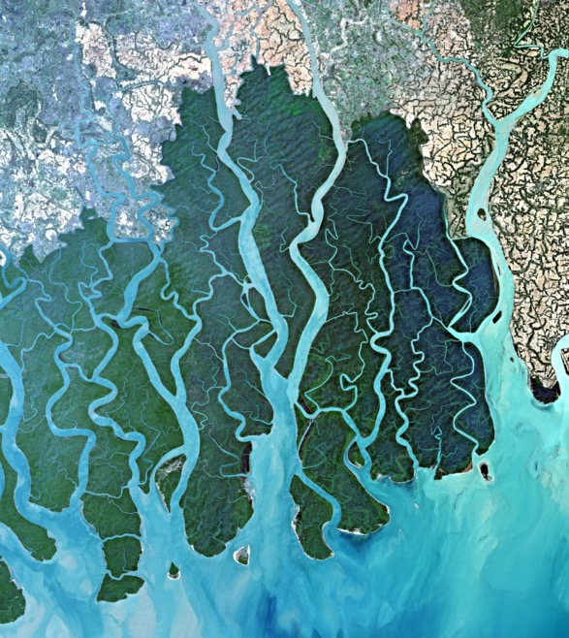


FRM4VEG (Fiducial Reference Measurements for Vegetation)
We are currently focusing on the EO data acquired by ESA optical satellites.
Acronym | Product | Brief Description
SR | Surface Reflectance | Bottom-of-atmosphere and topography corrected reflectance
OGVI | OLCI Global Vegetation Index | Green Fraction of Absorbed Photosynthetically Active Radiation (FAPAR)
OTCI | OLCI Terrestrial Chlorophyll Index | Index related to related to the total chlorophyll content.
LST | Land Surface Temperature | Radiative skin temperature (°K) of the ground.
S1 TOC 100m
Many more coming soon...
Sentinel-2, Ganges Delta, India

Slide 10
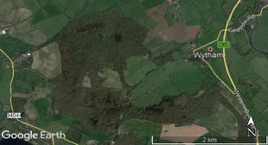
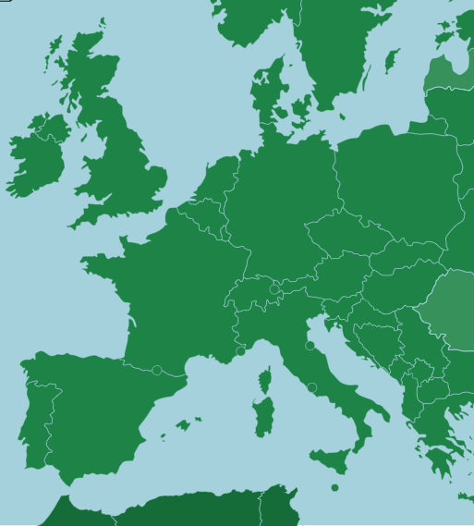
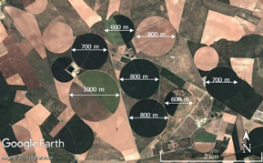
FRM4VEG – What has been done so far?
KO of Phase 1
END of Phase 1
2 FIELD CAMPAIGNS
March 2018
Summer 2018
March 2019
Wytham Woods (UK)
Barrax (Spain)

Slide 11

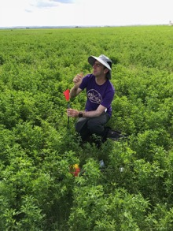
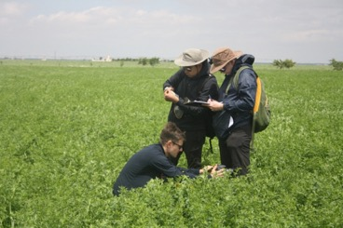
FRM4VEG – What has been done so far?
KO of Phase 1
END of Phase 1
2 FIELD CAMPAIGNS
March 2018
Summer 2018
March 2019
Wytham Woods (UK)
- Experimental farm.
- Flat terrain.
- Generally clear skies.
- 2 hours driving from Valencia
Barrax (Spain)

Slide 12
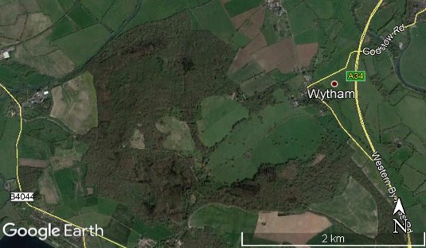
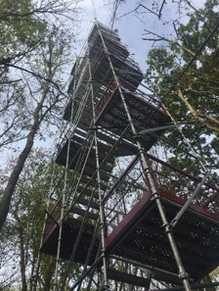
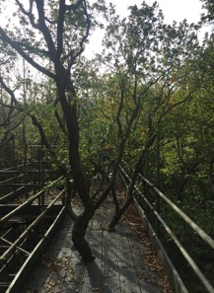
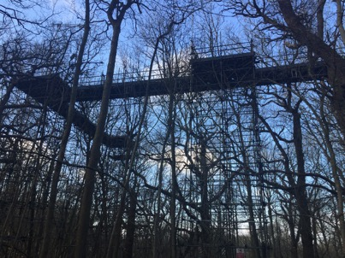
FRM4VEG – What has been done so far?
KO of Phase 1
END of Phase 1
2 FIELD CAMPAIGNS
March 2018
Summer 2018
March 2019
Semi-natural woodland (Oak, Ash, Beech, Hazel, Sycamore);
Managed research forest with ∼ 75 years of ecological monitoring;
Canopy walkway, Flux tower
Wytham Woods (UK)
Barrax (Spain)

Slide 13


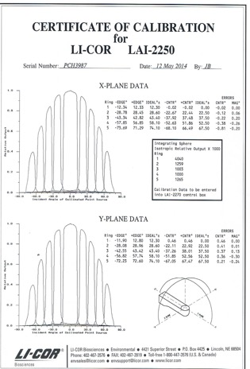
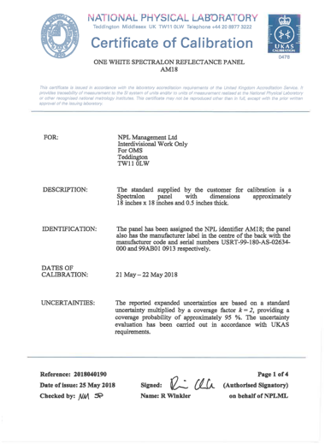
FRM4VEG – What has been done so far?
Instrument Calibration history and certificates
DRAFT
DRAFT
FRM Protocols
and Procedures
Validation Methodology
+ Instruments Technical Handbooks

Slide 14
FRM4VEG – What’s next?
KO of Phase 2
END of Phase 2
2 FIELD CAMPAIGNS
End 2019 /
Beg. 2020
End 2021 / Beg. 2022
Selection of one or two European sites (goal: 1 forest and 1 agricultural) to be the first European Supersites for Land Product Validation.
Identification of what has to be done in order to make them actual Supersites (e.g. which instrumentation has to be permanently installed, how measurements have to be taken, how characterization of the sites has to be performed, etc.)

Slide 15
FRM4VEG – What’s next?
KO of Phase 2
END of Phase 2
2 FIELD CAMPAIGNS
1 Inter-comparison exercise
End 2021 / Beg. 2022
End 2019 /
Beg. 2020
1 Workshop
to bring together the international community.
to have a fruitful discussion on protocols, sites characterization, etc. so to achieve a common understanding and agreement

Slide 16

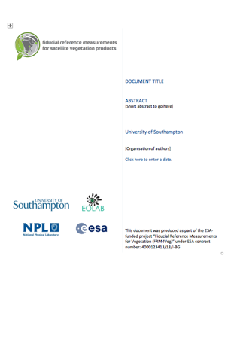
FRM4VEG – What’s next?
KO of Phase 2
END of Phase 2
2 FIELD CAMPAIGNS
End 2019 /
Beg. 2020
End 2021 / Beg. 2022
FRM Protocols
and Procedures
Validation Methodology
Generation of fully documented Protocols and Procedures to be implemented in order to proper validate the considered EO data and ensure full traceability trough the validation process.

Slide 17
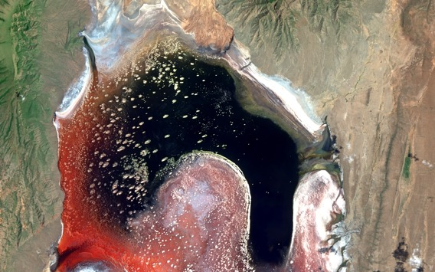
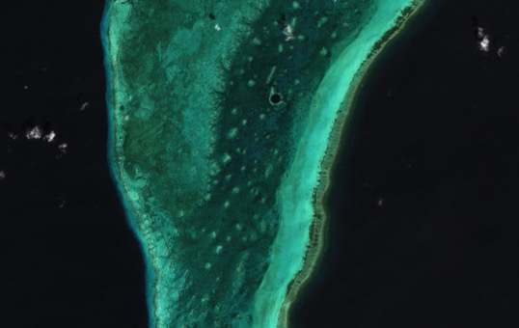
A few remarks
We are currently in the process of identifying and selecting the first European sites to become part of the Supersites Network for Land Products Validation.
They are meant to be operationally used for validation and to give ”the good example” to the other validation sites that wish to become part of the Supersites Network.
In order to do that, we need feedback from CEOS LPV.
Those sites need to be in the CEOS list of Supersites.
Sentinel-2, Lake Natron, Africa
Sentinel-2, The Great Blue hole:
Lighthouse Reef – Belize Barrier reef

Slide 18
Site / Characteristics | Jarvselja | Hainich | Lonzee | Hyytiala (SMEAR II) | Juelich | Tharandt | Fontainbleau (Barbeau) | Aurade
Location | Estonia | Germany | Belgium | Finland | Germany | Germany | France | France
Vegetation type | Mixed forest | broadleaf, deciduous | agricultural | needleleaf, evergreen | managed grassland | needleleaf, evergreen | broadleaf, deciduous | agricultural
Homogeneous vegetation cover at least (1km x 1km) or greater | Yes | yes | no | yes (different stand ages) | No | yes (in terms of mixed forest type and stand ages) | No | No
Homogeneous vegetation cover at least (300m x 300m) (with at least 2x - 3x area surrounding having similar spectral characteristics) | Yes | yes | yes | yes | Yes | yes (in terms of mixed forest type and stand ages) | Yes | Yes (just about…)
Relatively flat terrain | Yes | slight slope | yes | undulating | Yes | yes | Yes | Slight valley
Above / Canopy access via tower or similar | Yes 130m tower | yes; walk-up tower | crop measurement micromasts | 128m, 35m, 18m towers | Yes | canopy tower for flux measurments | Yes | yes
Aeronet sensor or similar | Yes |  |  |  | No |  | Yes
Suitable area for launching UAV | Yes | yes | yes | yes | Yes | yes | Yes | yes
power for recharging equipment | No | yes | yes | yes | No | yes | No | yes
Site management for maintenance and troubleshooting | Tartu Observatory | yes | yes | yes | Yes | yes | ESE Lab | CESBIO
Association with other network (i.e. FLUXNET, ICOS, LTER, CEOS) | ICOS | ICOS, GBOV phase 2 | ICOS, CarboEuropeIP | CarboExtreme, ICOS, InGOS, GHG-Europe, IMECC, EuroFlux, CarboEuroFlux, CarboEuropeIP | Fluxnet ICOS TERENO | CarboExtreme, ICOS, EuroFlux, CarboEuroFlux, CarboEuropeIP | ICOS Fluxnet | ICOS; CESBIO
Work in progress

Slide 19
A few remarks
We are currently in the process of identifying and selecting the first European sites to become part of the Supersites Network for Land Products Validation.
They are meant to be operationally used for validation and to give ”the good example” to the other validation sites that wish to become part of the Supersites Network.
In order to do that, we need feedback from CEOS LPV.
Those sites need to be in the CEOS list of Supersites.
By the end of FRM4VEG Phase 2, we will ask CEOS LPV for feedback on the FRM Protocols and Procedures documents we are writing.
We hope for CEOS LPV endorsement and the creation of a related CEOS document(s).
Those Protocols and Procedures are meant to be adopted and implemented operationally throughout the Supersites Network for Land Validation Products at international level.

Slide 20
A few remarks
We are open for collaborations with other Entities/Institutes that have similar activities and are interested in setting up the first two European sites of the Supersites Network for Land Product Validation.
We see some potential opportunities also from the Hypernet project. We are currently investigating on it and suggestions are welcomed.

Slide 21
ESA is contributing to the establishment of such Supersite network through:
FRM4VEG project (Fiducial Reference Measurements for Vegetation)
Preparation activities for the BIOMASS mission
Sentinel-2 - Lake Mackay, western Australia

Slide 22
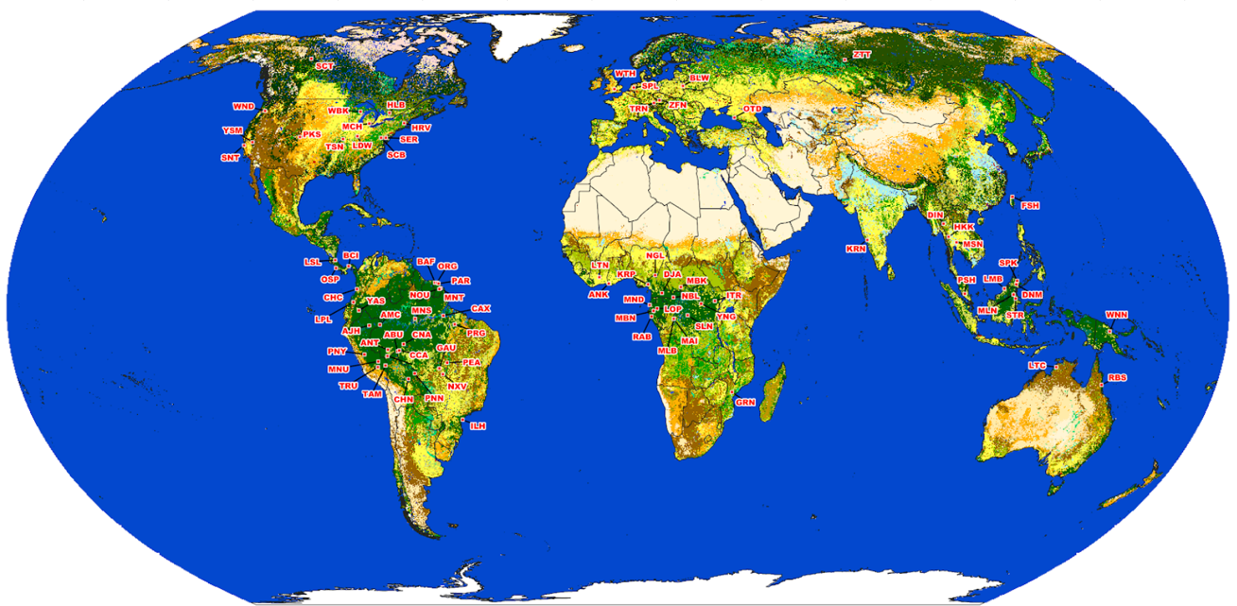
ESA support to LPV subgroup on biomass: potential supersites
Airborne campaign support
In-situ campaign support
Potential future support
Work in progress
Notes:
Optional slide: the map on the rihght will be most certainly presented by Laura
There have been airborne campaigns performed by ESA and NASA, … , we see some potential future support TBD.

Slide 23
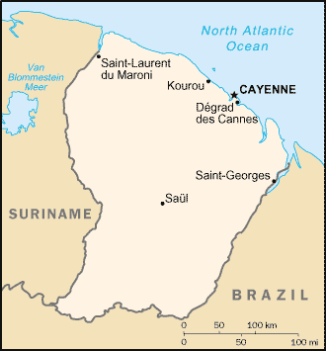
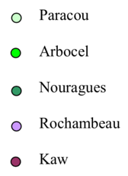
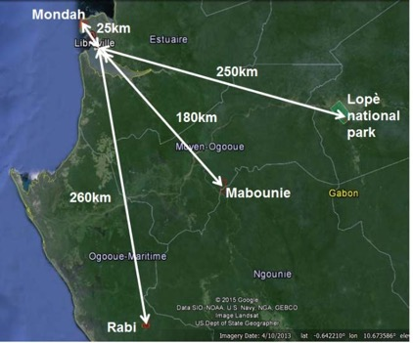
Airborne campaign support
French Guiana (Neotropical forest)
TropiSAR 2009 airborne campaign
Neotropical forest
Field campaign (782 Forest plots caracterised)
P-band SAR, L-band SAR
LIDAR
Supersites imaged:
Paracou
Nouragues
Arbocel
Potential future supersites:
BAFOG
Montagne tortue
Organabo
Gabon (Afrotropical forest)
AfriSAR 2015-2016 airborne campaign
Afrotropical forest
Field campaign (363 Forest plots caracterised, TLS)
P-band SAR, L-band SAR
LIDAR
2 Airborne Instruments: DLR F-SAR (P- and L-band SAR), ONERA Sethi (P-band SAR)
Collaboration with NASA: JPL UAVSAR (L-band SAR), GSFC LVIS (canopy lidar)
Joint operations collocated in time and space
Supersites imaged:
Lopé
Mabounie
Mondah
Rabi
Notes:
Spatial dimension.

Slide 24
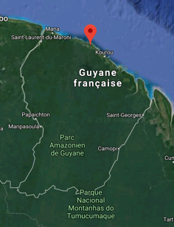
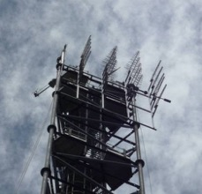
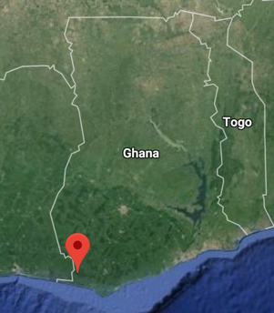
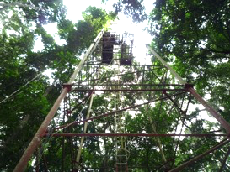
In-situ campaign support
French Guiana (Neotropical forest)
TropiScat 2011-2014 in-situ campaign
P-band and L-band SAR
Full polarimetric and tomographic
Measurements every 15 minutes
Supersites imaged:
Paracou
Ghana (Afrotropical forest)
AfriScat 2015-2016 in-situ campaign
P-band and L-band SAR
Full polarimetric and tomographic
Measurements every 10 minutes
Supersites imaged:
Ankasa
Notes:
Temporal dimension. We are taking measurements over a few pixels (5 to 10) over a 2-3 years period, every 15 minutes.

Slide 25
Other potential future support
Gobabeb | NAMIBIA
Collelongo | ITALY
Fyodorovskoye | RUSSIA
Mata Seca | BRASIL
Peace River | CANADA
Wytham Woods | UK
Aurade | FRANCE
Bily Kriz forest | CZECHIA
Brasschaat | BELGIUM
Castelporziano2 | ITALY
Fontainebleau-Barbeau | FRANCE
Hesse | FRANCE
Hohes Holz | DEUTSCHLAND
Hyytiala | FINLAND
Lanzhot | CZECHIA
Lison | ITALY
Montiers sur Saulx | FRANCE
Puechabon | FRANCE
Selhausen Juelich | DEUTSCHLAND
Svartberget | SWEDEN
Tharandt | DEUTSCHLAND
Vielsalm | BELGIUM
Estrees-Mons A28 | FRANCE
Hainich | DEUTSCHLAND
Kenttarova | FINLAND
Loobos | NETHERLANDS
Purkersdorf | AUSTRIA
Ardennes | BELGIUM
Zofin | CZECH REPUBLIC
Jarvselja | ESTONIA
Speulderbos | NETHERLANDS
Bialowieski | POLAND
To be defined and agreed following the work of the CEOS LPV focus on Biomass.
(more info in the presentation of Laura Ducanson at 11:00)
Work in progress

Slide 26

Thank you
for your kind attention!
Valentina Boccia – valentina.boccia@esa.int
Sentinel-2, Namibia

